Slide 1
Guidance for
CTE Pathway Credential Recommendation
SB 123 – new section 10
Continual

Slide 2
Purpose
Substitute for HB 2466 and SB 123 New Sec. 10
Substitute for HB 2466 (page 3, new section 6) required the Kansas State Department of Education to conduct a survey of high­-value and standard value credentials and career and technical education courses offered to students enrolled in public high schools for the purpose of determining the needs for secondary career technical education credentialing. The CTE Credentials report was created and submitted to the House Committee on Education and the Senate Committee on Education prior to January 15, 2023.
Substitute for HB 2466 (New Sec. 7) (a) On or before July 31, 2023, and each July 31 thereafter, the state board of education shall review and approve a list of high-value industry-recognized credentials and a list of standard industry-recognized credentials.
The High-Value Credential list was created from the Excel in CTE (SB 155) Qualifying Credential Lists.
The Standard Credential list was created from the Kansas Pathway Assessments and Credentials (K-PAC) List.
Recently, SB 123 was passed and signed into law. The Kansas State Department of Education is to survey each school district to ask which career technical education credentials each school district offers that satisfies the definition of "industry-sought credential" under subsection (d).
(2) "industry-sought credential" means a career technical education credential that is:
(A) Repeatedly referenced in job postings; and
(B) frequently referred to by employers in communications with school districts as a career technical education credential that is in demand.
Please review the 2023-2024_Excel_in_CTE_SB155_Qualifying_Cred.pdf (kansasregents.org) list (the Excel in CTE Qualifying Credentials were utilized to create the High Value Credentials List). Please review this list and make any industry-sought credential additions that you feel need to be made.

Slide 3
Purpose
SB 123 New Sec. 10
The Career Technical Education Credential and Transition Incentive for Employment Success Act Survey
New Sec. 10. (a) This section shall be known and may be cited as the career technical education credential and transition incentive for employment success act. (b) Each school district that offers career technical education for students enrolled in any of the grades nine through 12 shall, upon request by any such student, pay any fees charged for any assessment or other examination that is required for such student to obtain an approved industry-sought career technical education credential.
(c) (1) On or before July 1, 2023, and each July 1 thereafter, the state board of education and state board of regents shall jointly conduct a survey of school districts and colleges on which career technical education credentials each school district offers that satisfies the definition of "industry-sought credential" under subsection (d).
(2) On or before July 31, 2023, and each July 31 thereafter, the state board of education and state board of regents, after consultation with the secretary of labor, the secretary of commerce and representatives of industries that recognize career technical education credentials, shall jointly approve a list of industry-sought credentials.
(d) As used in this section:
(1) "College" means any community college, technical college or the Washburn institute of technology; and
(2) "industry-sought credential" means a career technical education credential that is:
(A) Repeatedly referenced in job postings; and
(B) frequently referred to by employers in communications with school districts as a career technical education credential that is in demand.

Slide 4
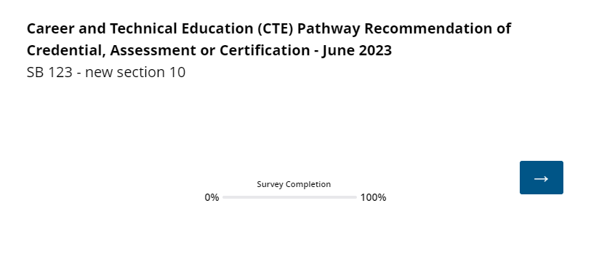
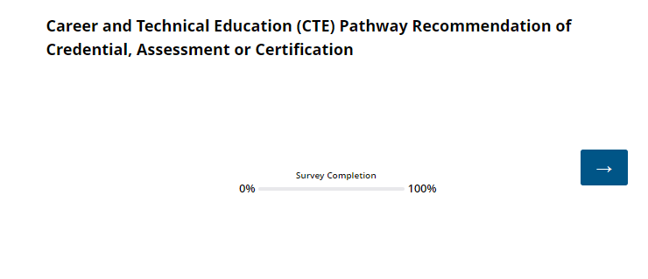

Slide 5
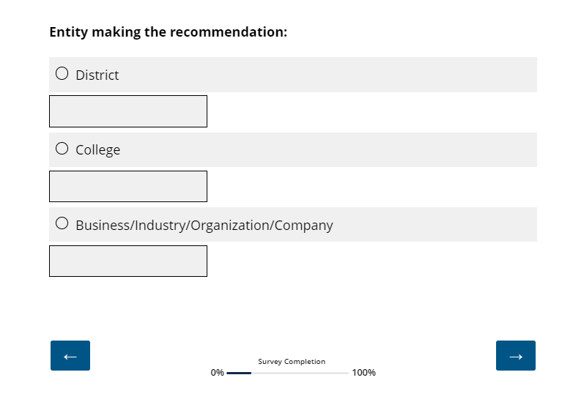

Slide 6
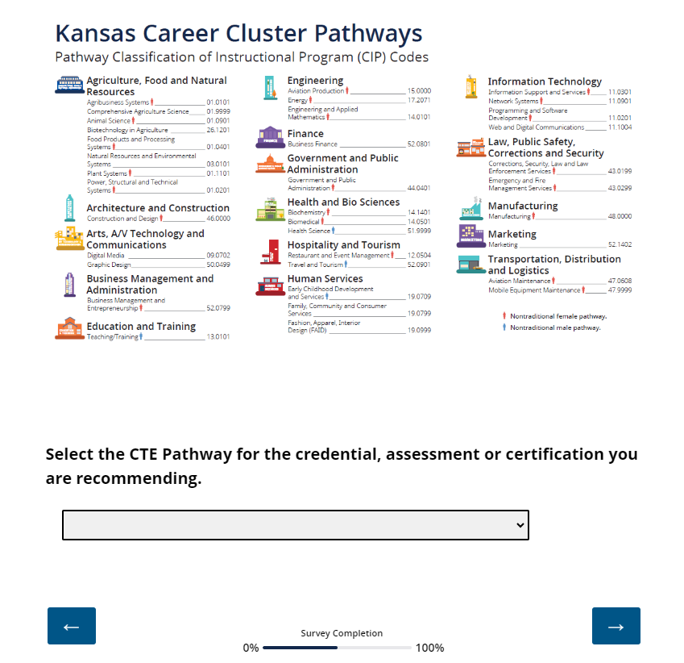

Slide 7
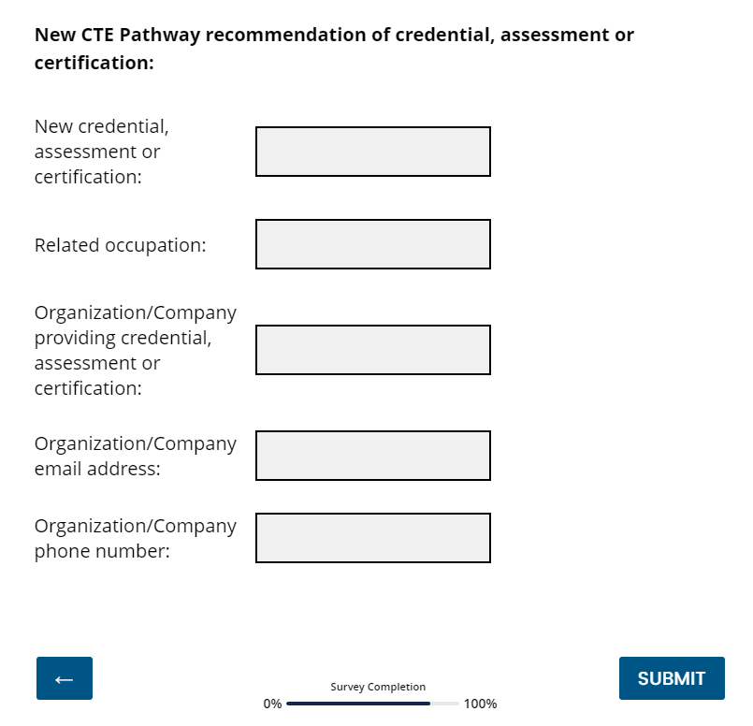

Slide 8
  CTE Contact:
  Career and Technical Education
  Natalie Clark
  (785) 296-4351
  ndclark@ksde.org
Survey Functionality Contact:
Qualtrics Administrator
Ann Yates
(785) 296-5140
ayates@ksde.org

